Slide 1
Finding and Engaging Your Audience
Amina Makhdoom Lynch
Fresnel Consulting
September 26, 2023

Slide 2
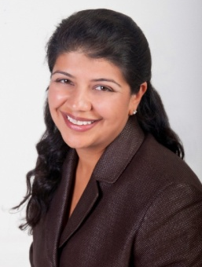
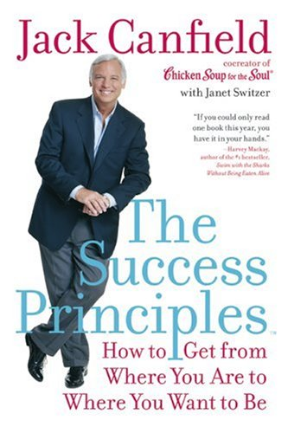
Introduction to Amina Makhdoom Lynch
Amina gently lifts and inspires others to achieve their highest dreams and enables them to contribute their unique talents in support of a world that works better for everyone.
25 years of Management Consulting experience (Accenture, Human Performance)
Over 30 years of training & facilitation experience -
Controversial Issues
Success Strategies
Business Skills
System Implementation
Conflict Resolution
Difficult Conversations
Heart-centered Leadership
Mentored by renowned author
Jack Canfield

Slide 3
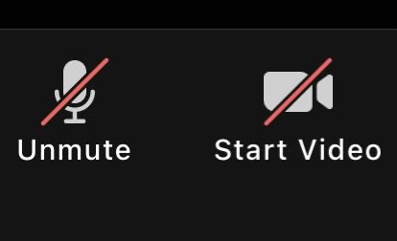
Reminders
This training is approximately 2 hours long. There will not be any breaks; however, if you need to step away, feel free to do so.
In order to ensure video quality, I recommend leaving cameras “off.”
I will be sharing my screen during the PowerPoint or have my camera on when speaking.
You will need paper and pen for this course.
RECORDING IN PROGRESS: The audio/video of this conference call is being recorded.

Slide 4
How will you show up to today’s class?
Take a moment now to decide how you will show up for our time together?
Turn your cell phone to silent or vibrate
Have materials to take notes
Set the personal intention that you will benefit from this session and leave with beneficial tools and information that you can use and apply.
QUESTIONS? Feel free to ask questions during the call by using the “Chat” feature. If I cannot get to them during the meeting, I will send responses to the group in a follow-up email.

Slide 5
Agenda
Welcome
Clarity of Message
Customer Experience and Personas
FB Demonstration
Creating a FB Group
Scheduling posts (for the year)
Ideas on where to get content that engages
FB Live
Questions and Closing

Slide 6
Know the value you provide to this audience
Notes:
What is the value of joining this organization?
Short and sweet
Addressing desires or pains of your audience (retired educators)
A place where you excel over the rest – our “bread and butter”

Slide 7
People find value in one of two ways….
Notes:
What do you do?
Do you help them to avoid pain? Or seek pleasure?
What is the need you fulfill?
Talking to people – what is their current pain?
What can you do to help
Wash State – mini-grants
Respect among teachers – allows them to do things to enhance their teaching

Slide 8
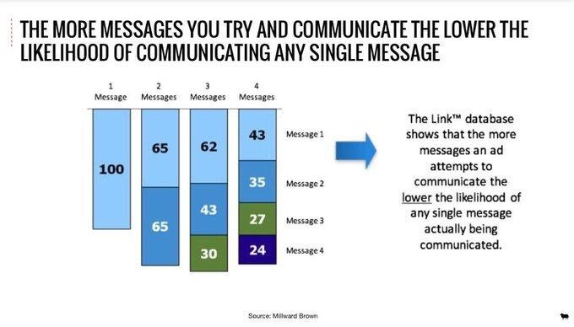
Data behind one clear message

Slide 9
What is your organization’s CLEAR mission?
Notes:
Short and sweet
The reason we exist
Not 100 – one clear one
What is it?
The one thing we are really here to do?
Share recent retiree’s motivation on why they are members and the value they get

Slide 10
What are some clear mission messages?
We protect your pension!
We advocate for retirement benefits you need.
We are the voice of retired educators on issues that matter.
Notes:
Our mission is to Protect your Pension.
You earned it, we want to make sure you get what you need to retire with ease.
We provide a service of monitoring all of the legislation that is introduced to ensure there is no negative impact to your hard-earned pension.
We are the only organization in the state that is dedicated to Protecting your Pension.
Here are some threats that have come up against your pension that we have helped to navigate.
When you join our organization, you provide a greater voice to protect the pension of all retired educators.

Slide 11
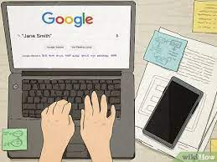
Where do you go to find information?
Always good to ensure you have a presence on the web.
Even if it is a basic website.

Slide 12
Website Content
Based on what you have heard so far, what would be good content to put on your website?
Mission Statement
Who you are (and if you can distinguish yourself from others) – such as the only organization that solely focuses on retired educators in the state of Maryland
Contact information
Include Facebook and other Social Media (SM) links here too
Overview of programs or how people can get involved
CLEAR next steps on how they can join, attend an event, or get on your mailing list

Slide 13
How do we engage? By thinking about…
Notes:
Biden Administration – big push these days
The idea that we are truly of service
Organizations exist to:
- Make a profit
- Be of service

Slide 14
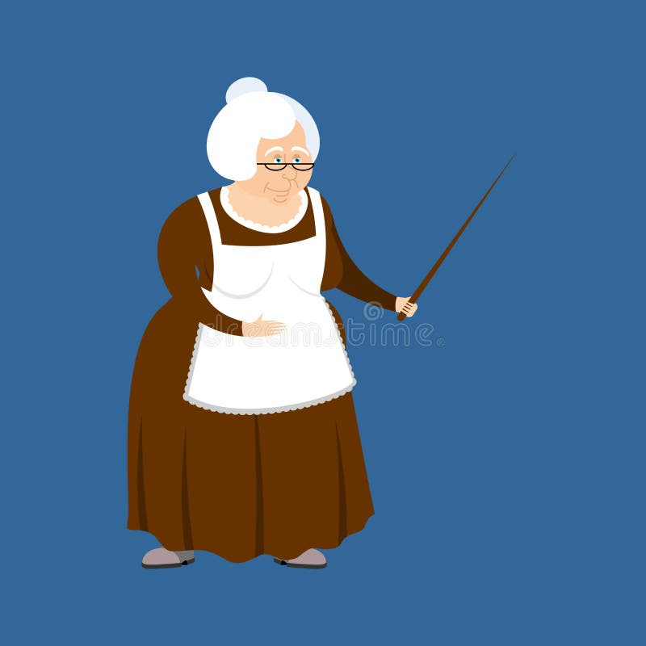
Are we speaking to our current retirees?

Slide 15
Deb - Maryland
Goals:
Travel – wants to live in other places and experience them
Gardening
Volunteer at NMAAHC in Washington DC (African American Museum)
Concerns/Worries:
Having enough money for the future
Kids having the same opportunities for success that I did
Needs:
Wants to know what is happening with the pension
Wants to stay connected to the school and community (substitute teach)
Technology
Other Information
Really want to travel and also substitute to stay connected
Happy with her pension, not feeling financial pressure
Not worried too much about long-term health care costs
Background Information
Single, kids and grandkids
36 years as a teacher
HS, MS and Elementary
Also taught in NY and NC
Retired in 2023 (new retiree)

Slide 16
Sara – New Jersey
Goals/Interest:
Travel to visit her kids whenever she wants (no worries about school calendar)
Substitute teach at my own school because I know how hard it is to find great substitutes that will follow the teacher’s plan and allow friends to actually take time off
Volunteer with local diaper bank
Reading, especially history (was a history teacher)
Background Information
Concerns/Worries:
Have had health issues (which is why I retired) – health is on my mind
No longer qualify for long term disability, wish all teachers knew to get this young
Going to have to get a job, because I will be bored and feel guilty since we still have kids in college
Stay on top of pension legislation
Has been trying to join state organization but cannot figure out how to
Married, with teenagers
Husband still working for 5 more years
26 years as a teacher
12 years with 10, 11, 12
14 years with 6, 7, 8
Retired on June 30, 2023 (new retiree!)
Technology used:

Slide 17
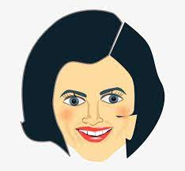
Joanne - MA
Goals
Marathon runner (started 10 years ago) and does one a year
Reading
Movies, shows, travel more
Concerns/Worries:
Stay active and health for herself and her kids
Want her kids to be happy and healthy – thinks about it a lot
Lost two friends in their 30s and health and living life is big on her mind
What am I going to do after I retire? How will I spend my time? Get a job just because don’t know what else to do.
Also, husband will retire about the same time – never had both at home at the same time
Definitely do NOT want to substitute, unless my school begs me to
Technology
Other Information
Happy with her pension especially since husband will get pension too
Not worried too much about long-term health care costs
Background Information
Married, kids in high school/college
30 years as a teacher
Middle school special education
Retiring in 2027 (3 years from now)

Slide 18
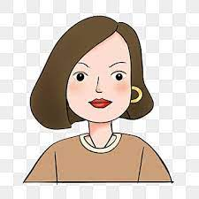
Cindy - Maryland
Goals/Interest:
Interested in travel, golf and literature
Relocate to our beach home
Concerns/Worries:
Impact of COVID on our students and therefore our future workforce
Impact of politics on our communities
Impact to women of current political movements
Background Information
Other Topics:
Feel good about my pension
Miss the people! Want to substitute to stay connected to the schools.
May spend time with other retired educators depending on what activity is being organized.
Married, kids
30 years as a teacher/administrator
8 years as a teacher
22 years as an administrator
Retired in 2023 (new retiree)
Technology used:

Slide 20
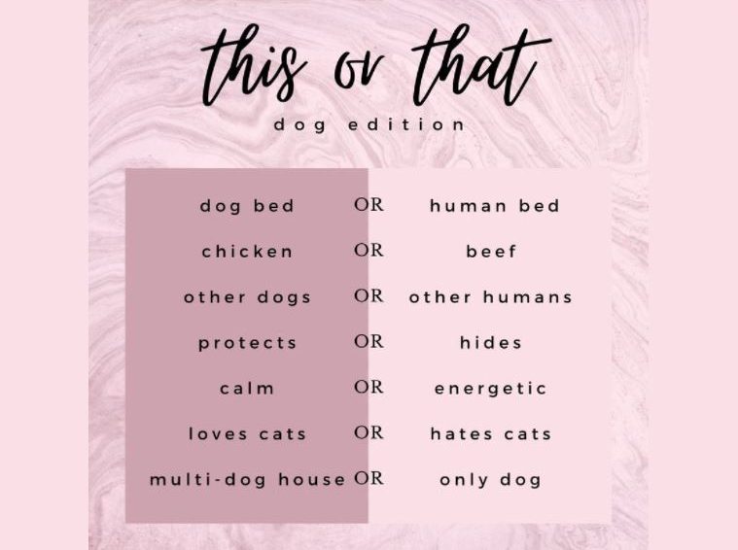
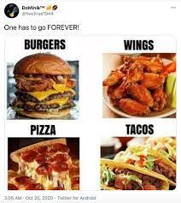
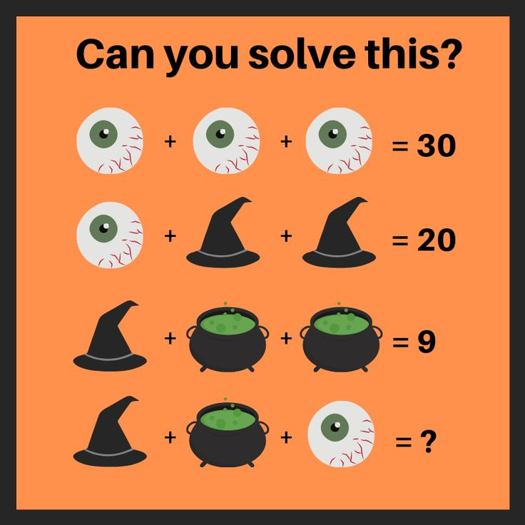
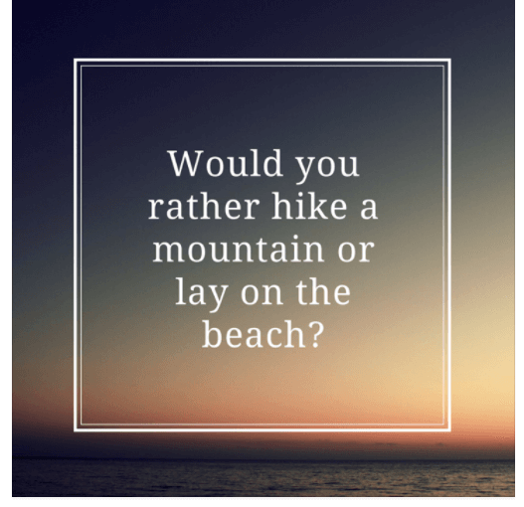
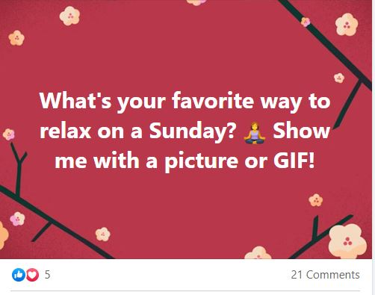
Facebook Engagement Posts
Just google: FB Engagement Posts

Slide 21
Best times to post on Facebook
The best times to post are Wednesday at 11 am and 1 pm.
The overall best day is Wednesday.
You will get the most consistent engagement on weekdays from 9 am–3 pm.
The worst day is Sunday, which sees the least amount of engagement.
https://influencermarketinghub.com/best-times-to-post-on-facebook/
https://sproutsocial.com/insights/best-times-to-post-on-facebook/#nonprofits

Slide 22
Facebook Demonstration

Slide 23
Resource
Available at:
http://www.amazon.com/My-Facebook-Seniors-2nd-Edition/dp/0789754312

Slide 24
Thank you!
Amina Makhdoom Lynch
Fresnel Consulting
(202) 425 8302
www.fresnelconsult.com

