Slide 1
Grant Winners
2024-2025

Slide 2
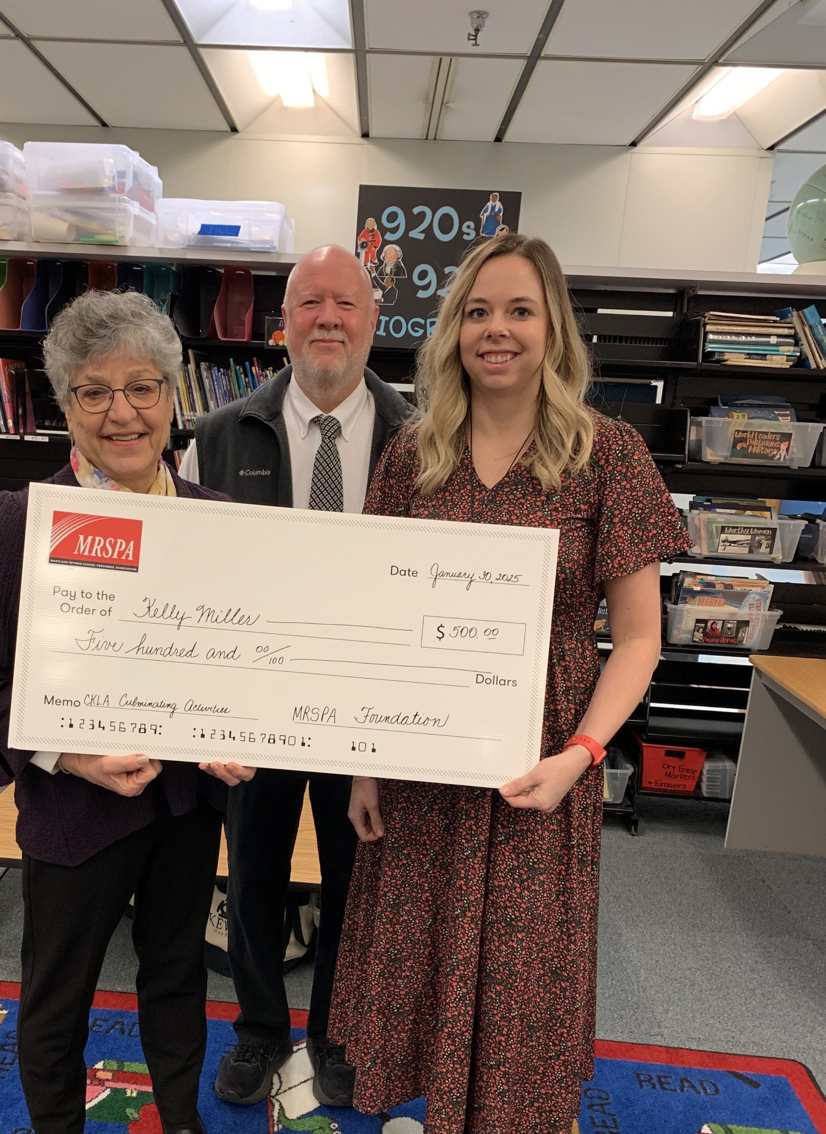
Area I West Allegany County Kelly Miller
Teacher at:
Flintstone Elementary School
Title:
CKLA Culminating Activities

Slide 3
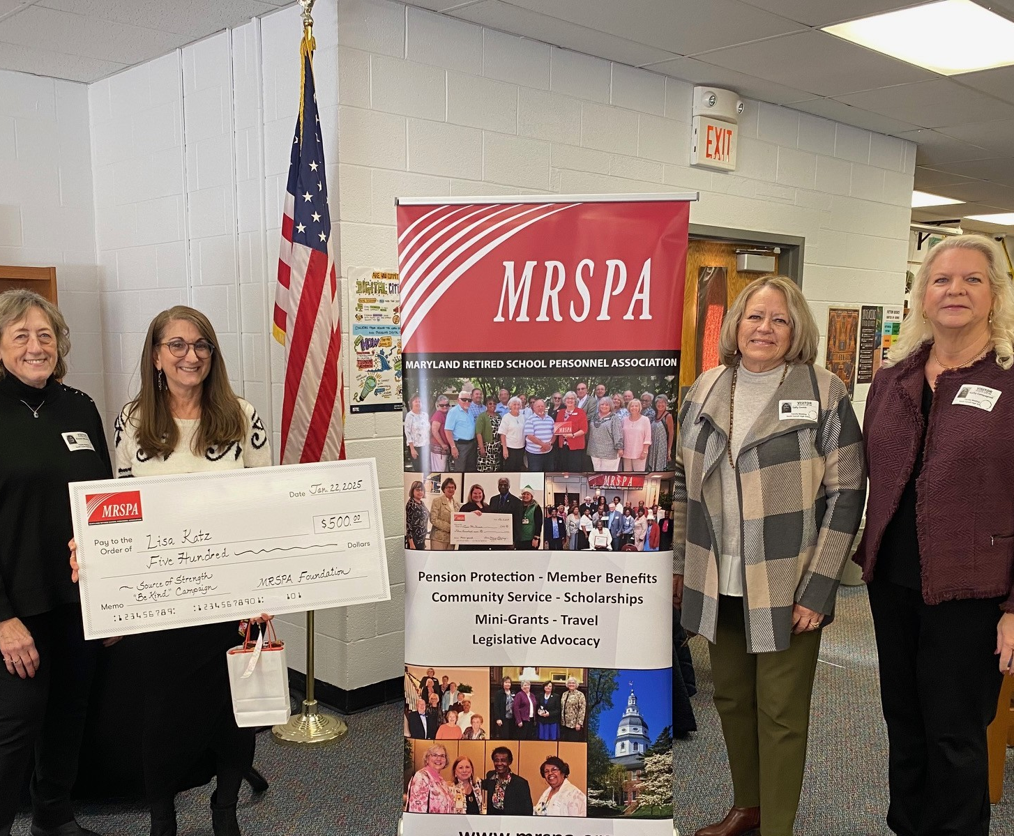
Area I East Carroll County Lisa Katz
Teacher at:
South Carroll High School
Title:
Sources of Strength "Be Kind" Campaign

Slide 4
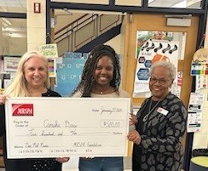
Area II North Baltimore County Canisha Drew
Teacher at:
Martin Boulevard Elementary School
Title:
Pen Pal Picnic

Slide 5
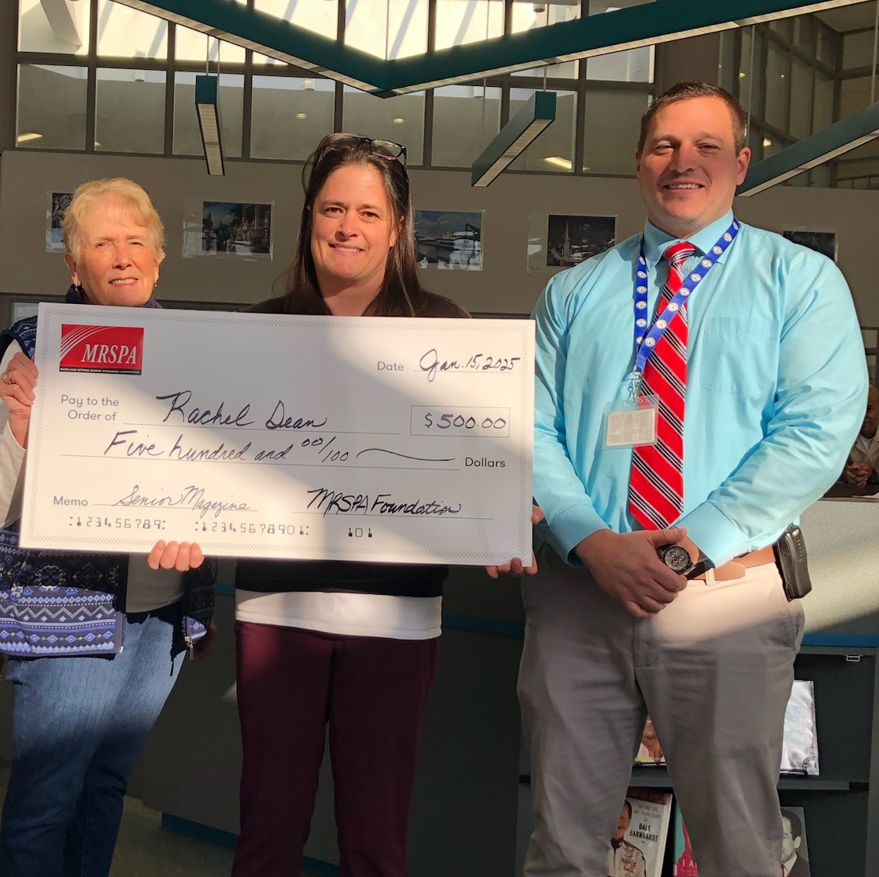
Area II South Calvert Rachel Dean
Teacher at:
Patuxent High School
Title:
Senior Magazine

Slide 6
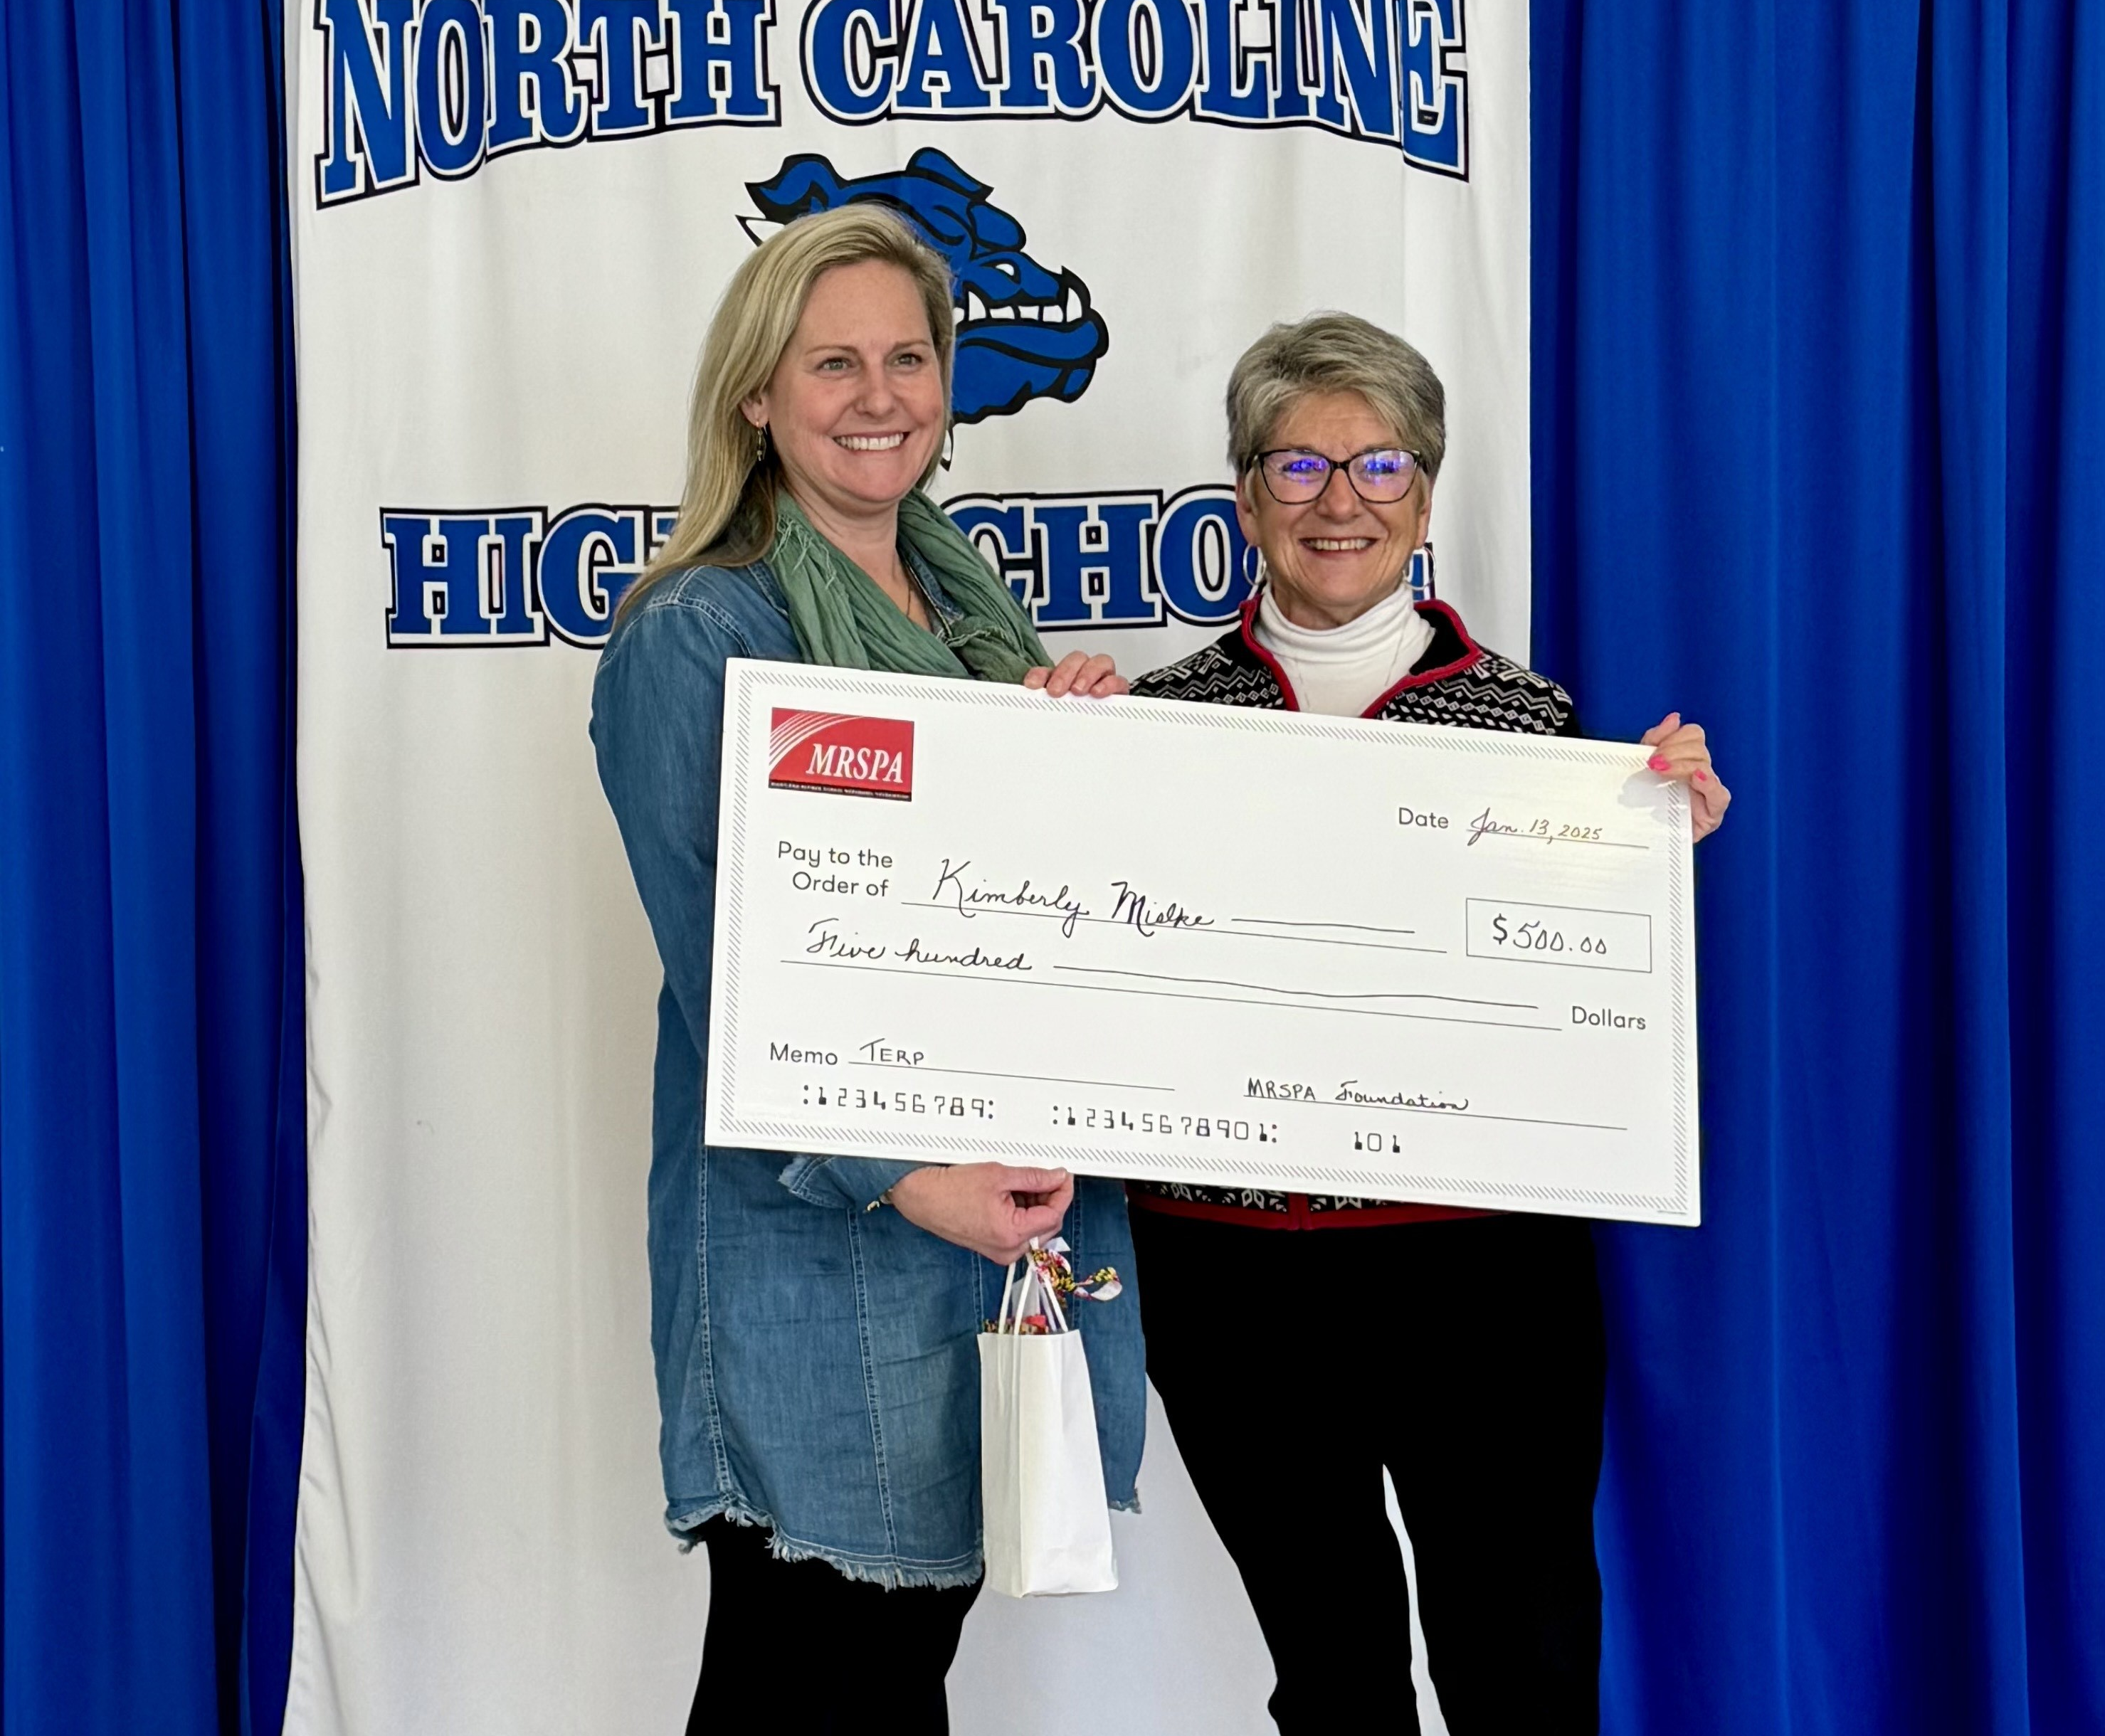
Area III North Caroline County Kimberly Mielke
Teacher at:
North Caroline High School
Title:
TERP

Slide 7
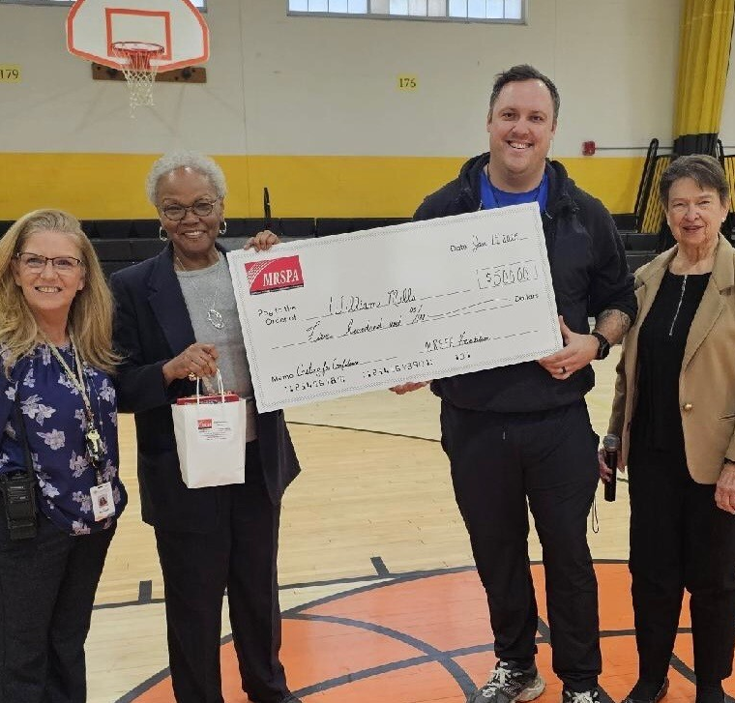
Area III South Wicomico County William Mills
Teacher at:
Wicomico Middle School
Title:
Casting for Confidence: Fishing for Change

